Slide 1
SOFIYA RESIDENSI (HOUSE RENOVATION)
To request quotation on the following Design ideas.
Unit Info:
Located at : Desa ParkCity, Kuala Lumpur
Size : 862sf
Bedrooms: 3 Beds & 2 Baths
Layout : Type A

Slide 2
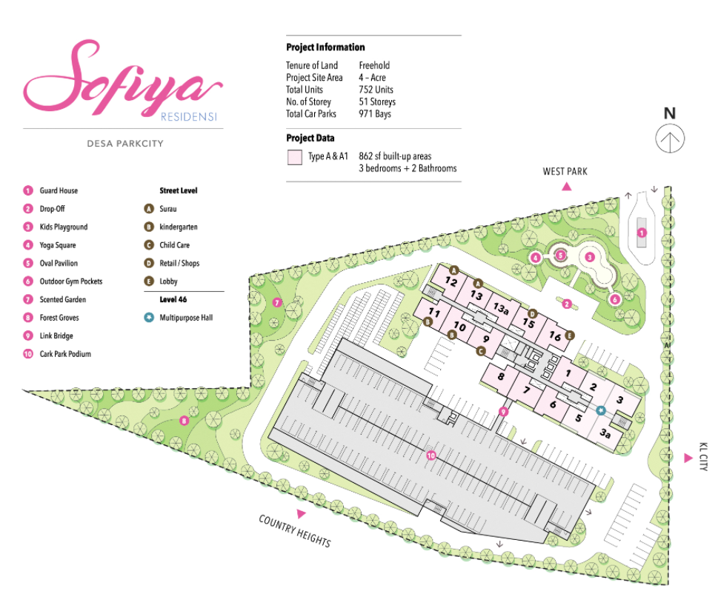
Overall Site Plan Layout

Slide 3
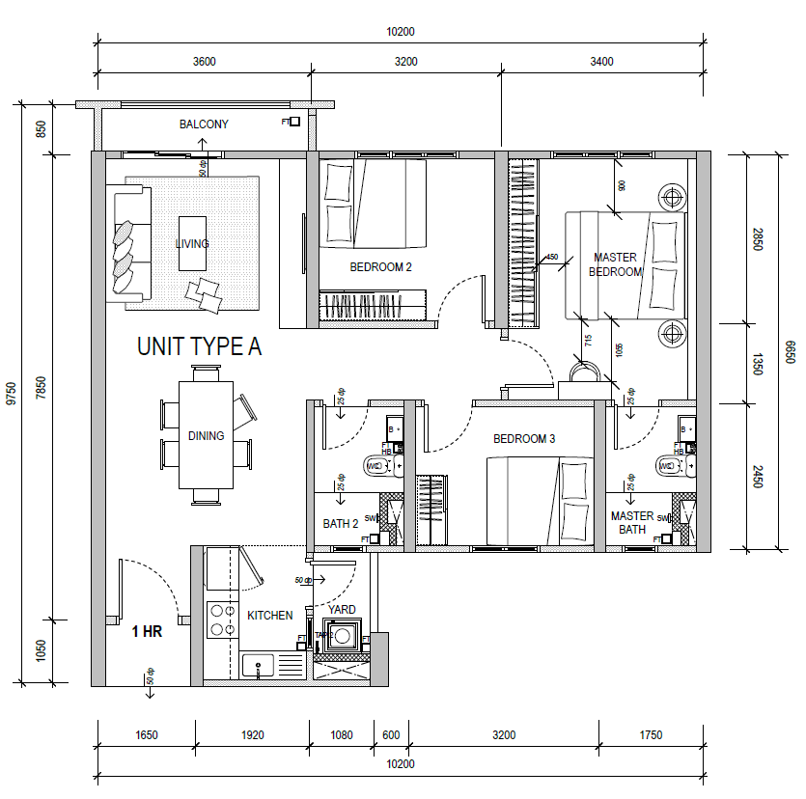
Unit Plan Layout (Type A)

Slide 4
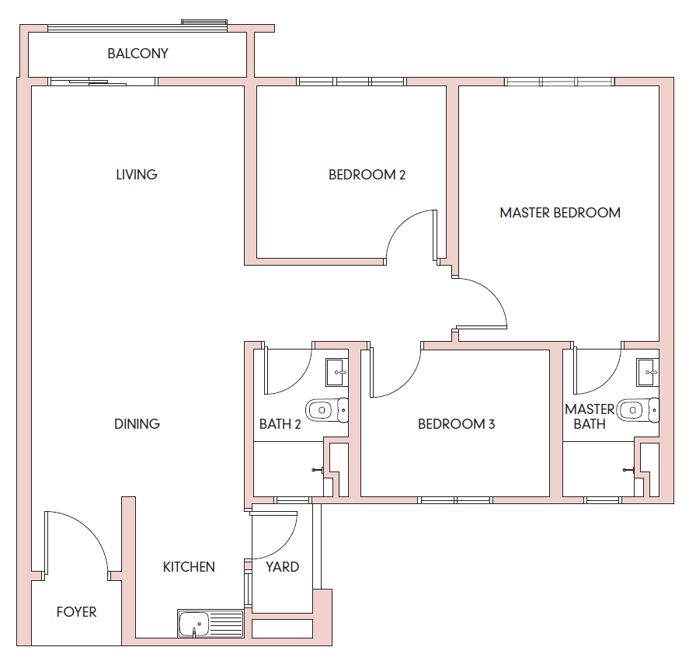
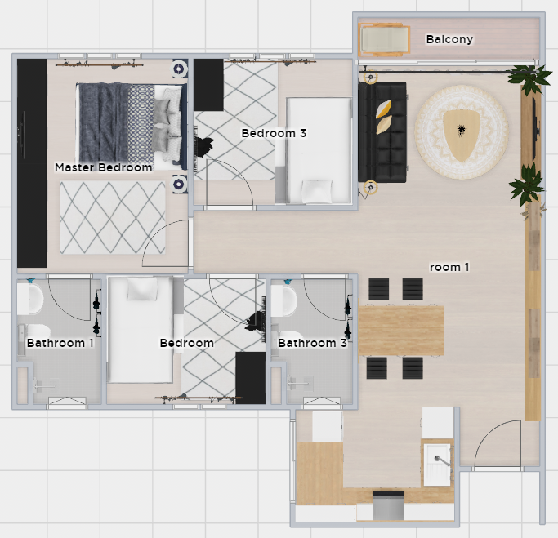
Top View (Unit Layout)
Overall design & mood board

Slide 5
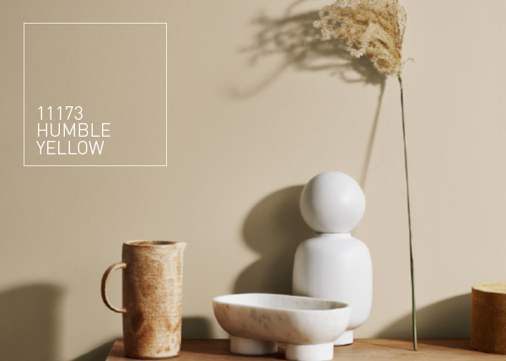

Internal Wall Paint (Living, Dining, hallway & Master Bedroom)
2
2
2
1
Jotun Majestic - 11173
1
1
1
2
2
Jotun Majestic - 11174
1
*Required costing for Painting works in the mentioned area.
*The Paint will be bought myself.
2

Slide 6
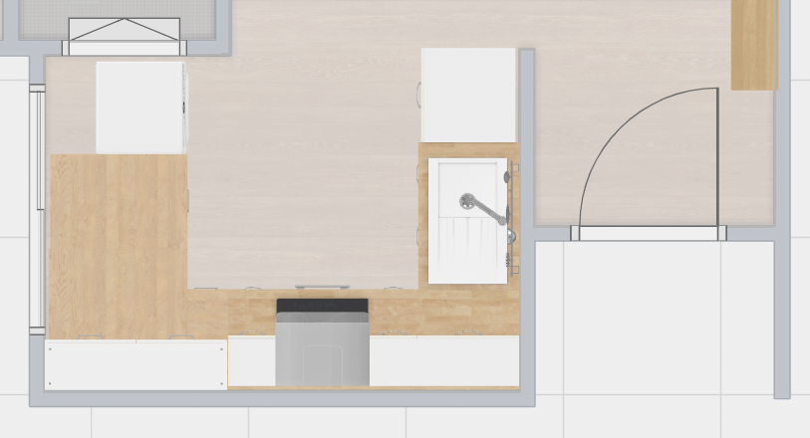
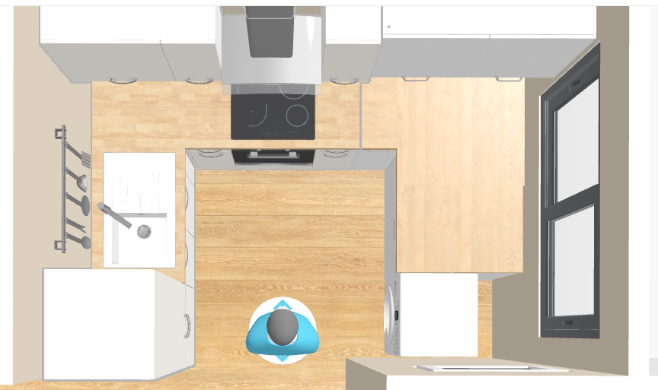
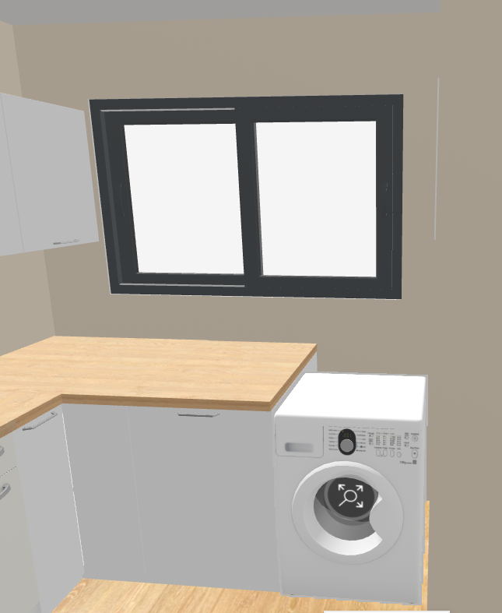
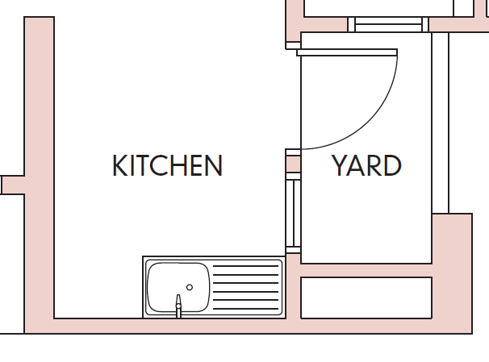
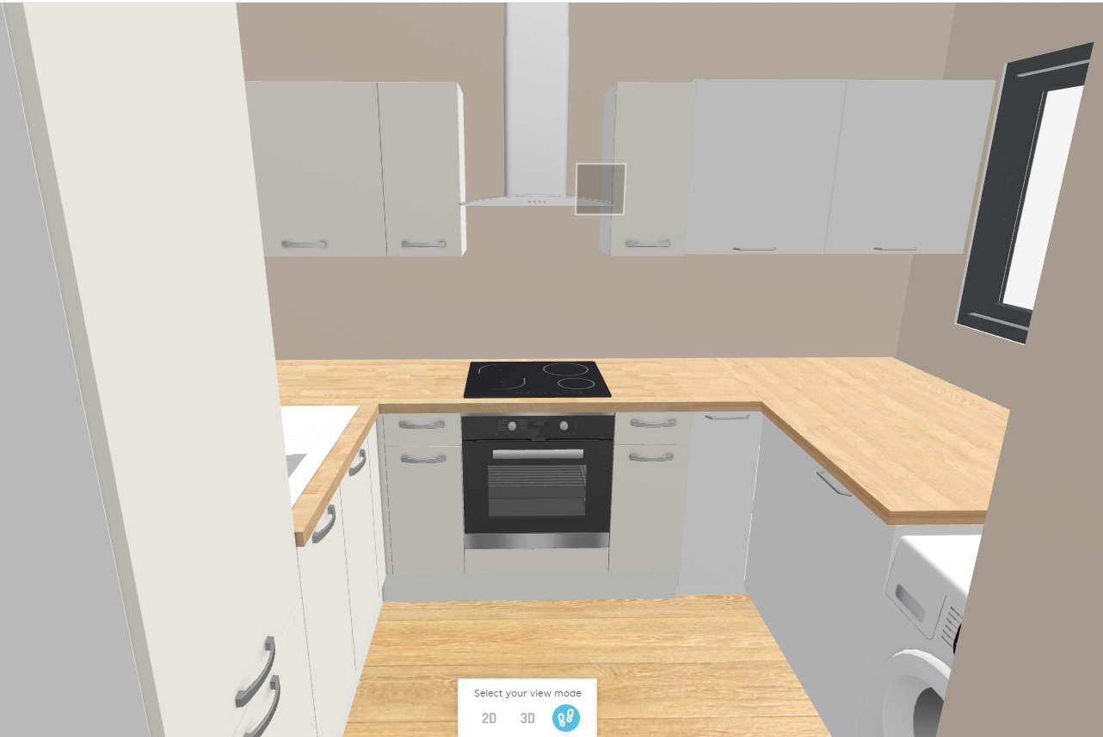
1
Renovation of Kitchen Area
Kitchen:
To extend the kitchen up to yard area – demolish windows and cement yard up to same level with kitchen.
Install ikea kitchen cabinet, sink, piping, washer & dryer, cooker hood & hob.
Close up the partial wall at yard and install sliding windows.
2
3
3
1
2
*Required costing for all hacking, cement & cabinet installations.

Slide 7
Additional Request:
Installation of:
Lamp & Fan
Laminated Timber Flooring (Living, dining, Kitchen, hallway & all bedrooms ~ 650sf)

