Slide 1
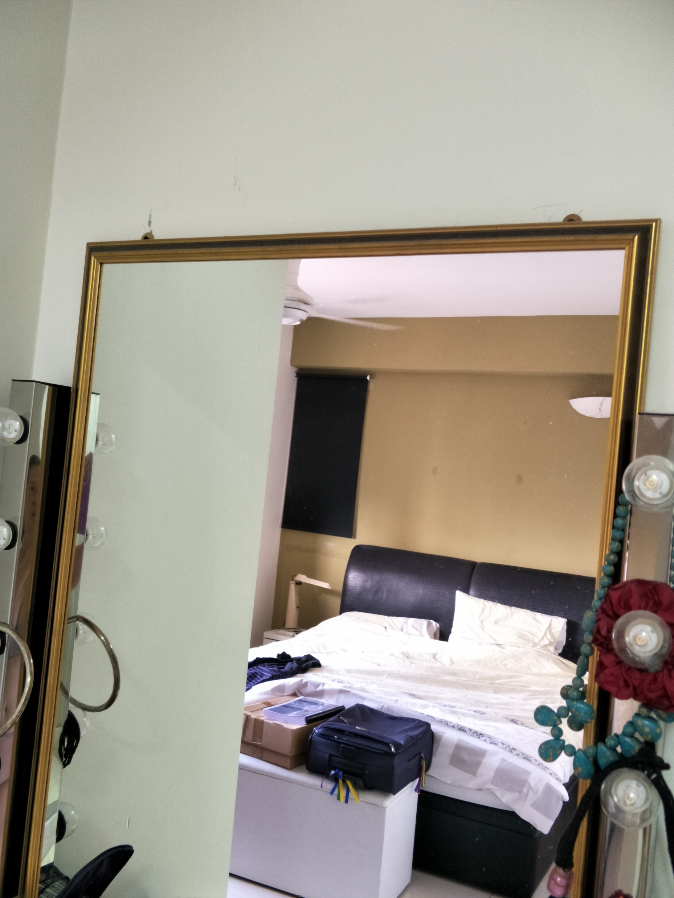
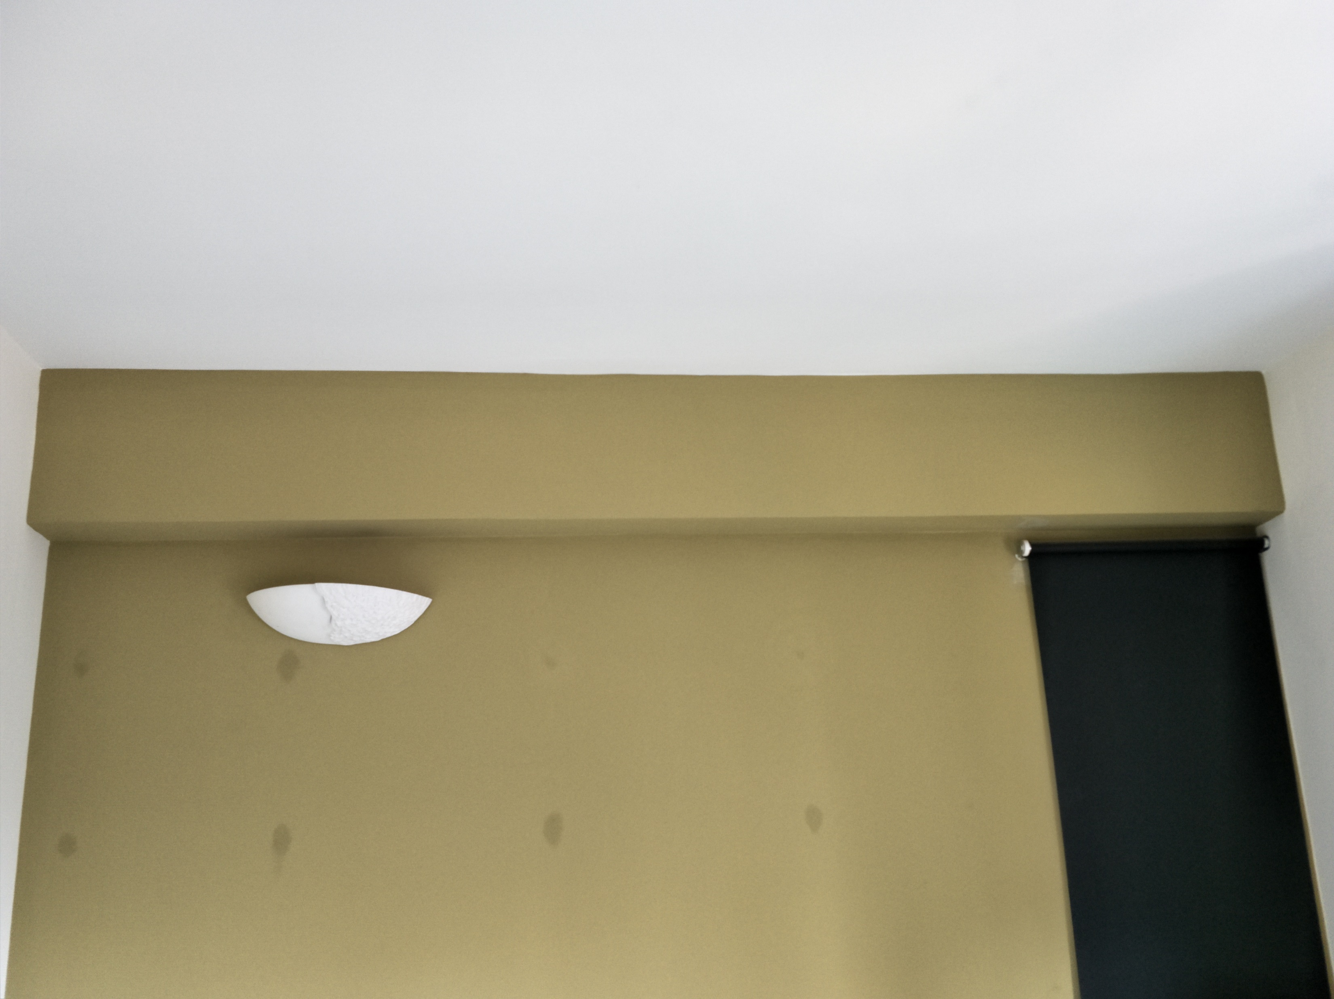
1. Service to install small fluorescent light
2. Service to install 2 long fluorescent lights on bedroom wall
3. Service to install 1 long fluorescent light on bedroom wall
4. Service to change pre-existing fluorescent lights in balcony to new set

